Slide 1
Data Science & Apache Spark Overview Data tools for Data Professionals
Notes:
Any data professionals?
Quick round table of who you are and what you do ….
Great! How many of you have heard of spark? Used spark?

Slide 2
Agenda & Recap
IBM Data Science Overview
Spark Overview
Hands-on Labs
Develop familiarity with the platform
Learn to deploy end-end applications with the platform
Networking
Notes:
Hands on labs will be in spark, and we will put into practice what we have gone over…
We have 3 labs and I normally give the room about 45 min- hour to do each lab....

Slide 3
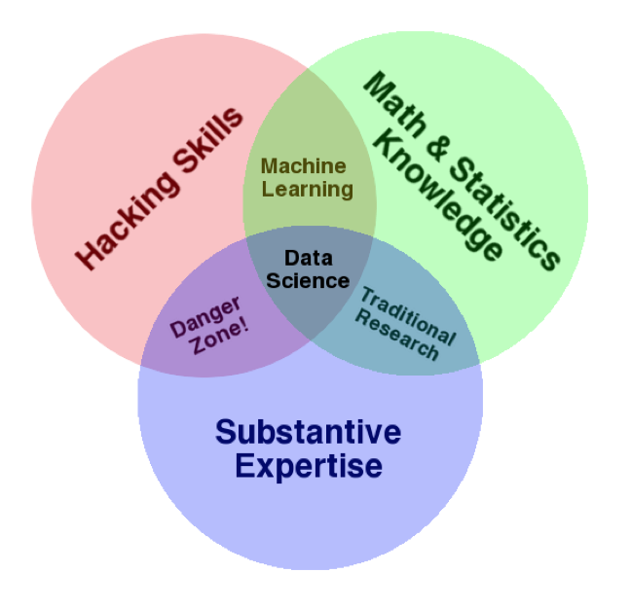
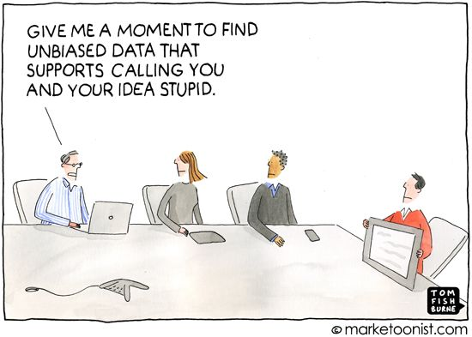
Data Science
What is it?
Why do we need it?
We need Data Science to make valid, objective inferences from data, free from human bias – KDNuggets
Notes:
It Is an interdisciplinary field
It sits at the intersection of quite a few skill sets
While Machine learning & Data Science are closely related, data science differentiates itself by also requiring domain knowledge.
For example, you may have some background in genomics and when presented with such a set, you apply what you know to convert your data into something which machine learning models can use, we will see a small example of this later on during our labs
**Or, in other words - - when given a problem to solve, such as improve user experience at a theme park - - you know the pieces of data that you’ll need to do predictive analytics
And while it is indeed a wide set of skills to be mastered, good news for us is that a lot of tools out there abstract away all the nitty gritties of these skills
**Data Science Experience is a great tool that simplifies many data science processes, depending on the user
All you need to know is the uses of each and how and where to apply them. We will see a some examples later on in our hands on lab
________
We need data science to be able to answer business questions (i.e. – why are customers churning? / what drives box office dollars in a given city/for a given movie.. Etc.)
You want to be able to know if the KPIs you have defined for your business are looking good/up to expectations, and if they are a result of your marketing efforts or some external factors.
More concisely, you want to be able to make decisions based on something solid and not just because your gut says so.
KDNuggets: leading site on BA, Big Data, Data Mining, Data Science and Machine Learning (Gregory Piatetski – Shapiro / Matthew Mayo)

Slide 4
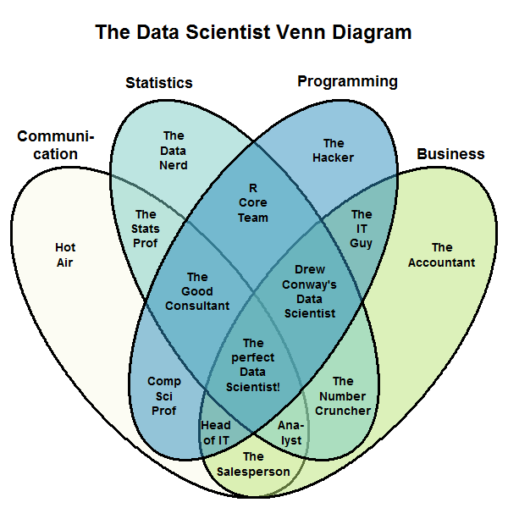
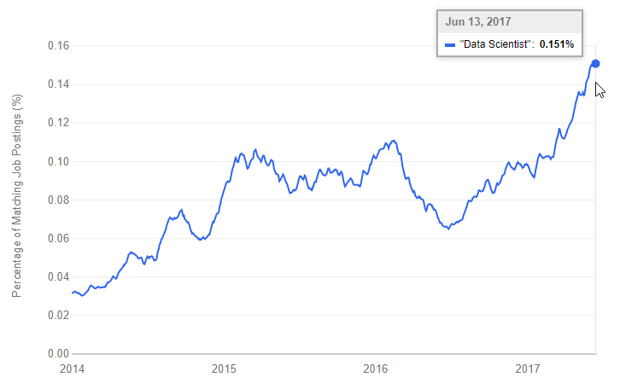
The Unicorn Data Scientist
Indeed.com Job Trends: “Data Scientist” https://www.indeed.com/jobtrends/q-%22Data-Scientist%22.html
“The data scientist is a savior who (if found) can solve all big data problems, so companies will not have to worry about figuring out how to do it themselves, all they need is to catch two or three really good data scientists, no matter what they are.” (2012) http://blogs.gartner.com/svetlana-sicular/data-scientist-mystified/
Stephen Kolassa: Update to Drew Conway’s Data Scientist Venn Diagram
(2014) https://datascience.stackexchange.com/questions/2403/data-science-without-knowledge-of-a-specific-topic-is-it-worth-pursuing-as-a-ca
Notes:
Some organizations see the Data Scientist as a Unicorn….
To succeed, a data scientist needs to bring to the table expertise across an incredibly wide set of disciplines – and this individual doesn’t just need to know the what’s now in IT, data science and domain – but be able to stay on top of the changes across all of this in a world that is rapidly changing
These individuals exist – however, waiting for these unique unicorn individuals is typically not practical. And these individuals are often not content working for an organization anyways – rather than talking about these unicorns, let’s think about how to activate data science within an organization as a team approach.

Slide 5

Data Scientist Persona: Current Challenges
Rigid toolset
Have to choose one and only one approach
Cannot easily connect all capabilities required
Difficult to navigate between various tools used
Fragmented and time consuming
Using multiple, disjoint environments
Separate, on-ramp/community for each tool/individual
Does not have metadata or data lineage
Analytical silo
Difficult to maintain and version control project assets
Limited means of collaborating with teams
Results are difficult to share
Notes:
We tried to highlight points which elongated “Time to Live “ in projects within business ….
Rigid toolset
Especially with different personas/different types of users
Fragmented & time consuming….

Slide 6

Data Science Is a Team Sport
Business Data Scientist
Technical Data Scientist
Professional Analyst
Developer
Business Analyst
Notes:
If we consider what we need for data science – and the skill profiles that IBM sees within its customer base, the market, and as described by thought leaders such as Forrester, Gartner, IDC, etc – several roles to consider –
Instead of an one individual work, we see it more as a team sport. Were we have several profiles and expertise that complements each other’s
Professional Analyst – the statistician, familiar with spread sheets and ad-hoc analyses. The usually develop researches inside an organization or as an individual professional or professor.
Business Analyst – is within a line of business function such as marketing, finance, operations, etc and is the one that is pushing for self-service to data – and for self-service that is more sophisticated than the static reports that have been the staple of BI for the past decade or so
Business Data Scientist – has emerged as advanced analytics have become more accessible – these are individuals that are comfortable with data, they understand some but not all advanced techniques, and they are comfortable with statistical concepts and maybe even some predictive modeling as long as its guided and visual
Technical Data Scientists – is a reboot of actuarial science, deep math, statisticians, data miners, game theorists, and econometric specialists. While the code of data science has been around for a while, it has gotten easier to work with (Rstudio), easier to get (open source) and more powerful thanks to the community approach to development embraced by the open source community. These are the new rock stars that are versed in Python, Spark, R – but these individuals need the guidance of the business to be most effective
Developers are increasingly important to this – as data sources become more complex, and deployment needs are more sophisticated, developers are called upon to turn what data science has uncovered into new ways of doing business
What these individual need more than ever is a way of working together. Today, each has their own tools and their own ways of doing things – creating new silos of insight at

Slide 7
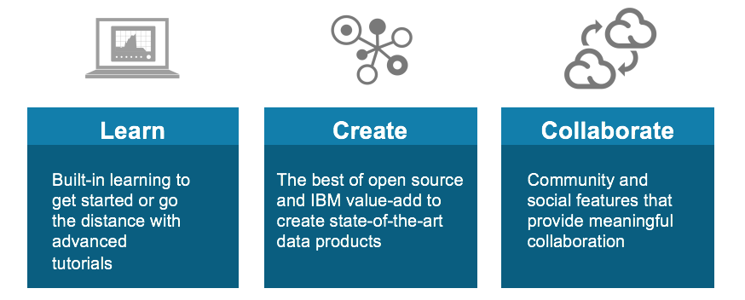

IBM Data Science Experience
http://datascience.ibm.com
Notes:
DSX is a single platform to Learn, Create, and Collaborate – the 3 pillars of a successful data science organization.
Learn: Learn from each other & develop new skills
Benefit from the community aspect, read recently published articles, leverage tutorials and existing notebooks to do things you’ve never done before
Create: Create projects in the environment of your choice
Seamlessly….with all tools and data at your fingertips
Collaborate: Within your organization, with your colleagues and outside - with other data professionals (you even chat with data scientists from IBM).

Slide 8
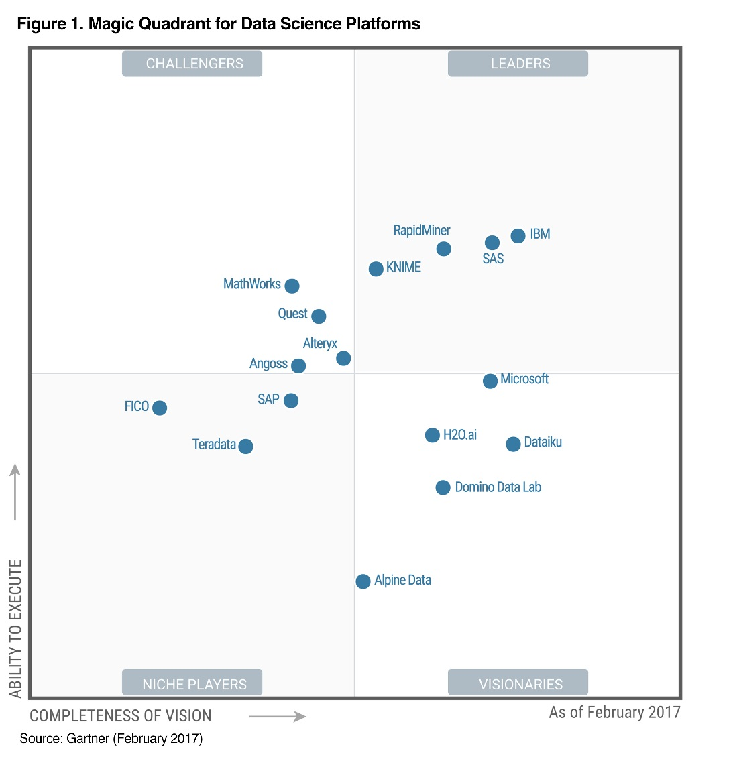
2017 Gartner Magic Quadrant for Data Science Platforms
IBM is positioned as a Leader in the 2017 Gartner Magic Quadrant for Data Science Platforms, based on its ability to execute and completeness of vision.
IBM is positioned highest in execution and furthest in vision within the Leaders Quadrant.
This is the fourth consecutive year for IBM to be recognized as a leader in this report.
Source: Gartner Magic Quadrant for Data Science Platforms, Alexander Linden, Peter Krensky, Jim Hare, Carlie J. Idoine, Svetlana Sicular, Shubhangi Vashisth, 14 February 2017.
This graphic was published by Gartner, Inc. as part of a larger research document and should be evaluated in the context of the entire document. The Gartner document is available upon request from IBM. Gartner does not endorse any vendor, product or service depicted in its research publications, and does not advise technology users to select only those vendors with the highest ratings or other designation. Gartner research publications consist of the opinions of Gartner's research organization and should not be construed as statements of fact. Gartner disclaims all warranties, expressed or implied, with respect to this research, including any warranties of merchantability or fitness for a particular purpose.

Slide 9

Spark is an open source
in-memory application framework for
distributed data processing and
iterative analysis
on massive data volumes
" Analytic Operating System"
Notes:
Spark is an open source project which came out of UC Berkeley’s AMPLAB, now called the “RiseLab”
It is an in memory, distributed processing, engine
It is designed for heavy workloads
At IBM, we like to call it the “Analytic operating system”
We actually funded the initial Amplab project and continue to fund Riselab

Slide 10
Key Reasons for Interest in Spark
Performant
Productive
Leverages existing investments
Improves with age
Notes:
Performant:
Fast (20-100x faster when compared to Hadoop MapReduce)
Productive:
- Lesser code lines
One of the reasons for increased productivity is the fact that Spark comes with a set of classes and methods that allow a programmer to get to the desired result faster. MapReduce did not have those pre-built capabilities.
NOTE: having pre-built capabilities does not necessarily remove the learning curve to become competent with the product.
Leverage Existing Investments:
You can still use your Hadoop environment
No wastage….
Improves with Age:
Extremely popular
Code evolves quickly
Becomes easier to use by the day...
* Spark is the largest and most active Apache project. As we’ll see later, the product has evolved quickly and will
certainly continue to do so for quite a while.

Slide 11










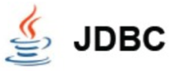



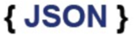





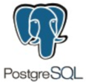






From a Notebook…
Execute SQL Statements
Streaming Analytics via Micro-batch
M.L. and Statistical Algorithms
Distributed Graph Processing Framework
Spark SQL
Spark Streaming
MLlib Machine Learning
Graph
General compute engine
Basic I/O functions
Task dispatching
Scheduling
Spark Core
Data Sources
IBM Cloud | Public Cloud | Cloud Apps | On-Premises
BigInsights (HDFS)
Cloudant (DBaaS)
dashDB (Analytics)
SQDB (Managed DB2)
Swift (Object Storage)
You can use IBM’s managed Spark Service to blend multiple data types, sources and workloads
Notes:
From a Notebook in DSX you can use IBM Analytics for Apache Spark to blend multiple data types, sources, and workloads. IBM Analytics for Apache Spark is a fully managed service on Bluemix.
For example, Spark SQL is available to address the needs of so many of our current customers and partners that want to be able to work with their traditional relational databases, using a performant and powerful technology like Spark, but be able to do so without needing to know how to code MapReduce jobs in Java. Using SparkSQL, a developer can apply their knowledge of SQL statements directly in Spark code, and tap into a large number of relational databases Spark supports in order to apply in-memory analytics over bread and butter relational SQL databases.
And beyond SparkSQL, we can attack new problems with Spark’s machine learning library, Spark Streaming, and Graph. The power of Spark is the ease of developing analytics applications using a unified framework across all of these libraries. For more details on this please check the appendix of this deck.
Towards the bottom of the slide, I've highlighted the connection opportunities we have with Spark today – and keep in mind that this list is not exhaustive and is ever-expanding. Focus your attention particularly on the integrations with the IBM portfolio (on the left) that we support currently. Of course, the logical fits are there: connect Spark to BigInsights On-Premises or BigInsights on Cloud to land your data in HDFS and access the suite of enterprise-grade technologies we support atop BigInsights. But consider as well the dramatic innovations in areas like our button-push connectivity to databases like NoSQL database-as-a-service Cloudant. Application developers, Web services, and mobile apps now have direct-line access to an in-memory analytic processing framework that can even handle near-real time ingest of data from Internet of Things data streams and messaging hubs.
The best practice for the Spark service is using object storage (Swift) as the data store.

Slide 12
Hands-on Labs
https://github.com/tliakos/dsx-spark
Notes:
Git Repo: https://github.com/tliakos/dsx-spark
Box Folder with rides.csv: https://ibm.box.com/s/u4dii1af469o1dmwgav4o7s033x279m7

Slide 13
Lab 1 Summary
In this section explored some of the basic functionalities of DSX. We started by creating a new project. Within the project, we imported a notebook from a GitHub repository and then executed it. By executing each one of the notebook’s cells we learn how to create a RDD return single and multiple elements, explored map functions and inspect the elements of the multiple RDD created by scripting in Python. By leveraging Spark in your data projects, businesses improve their effectiveness managing large volumes of data effectively.

Slide 14
Lab 2 Summary
This section explored the basic functionalities of DSX. We started by creating a new project and importing a notebook from a GitHub repository to executed it. By executing each one of the notebook’s cells we learn how to create a RDD that return single and multiple elements. We also explored map functions and element inspections of the multiple RDD created by scripting in Python. The ease of use we experienced by combining SQL queries with the speed of Spark can significantly cut the time to value in any data science initiative leaving time to analyze the insights drawn from the data.

Slide 15
Lab 3 Summary
Lab 3 allowed the user to further explore machine learning within DSX. Users were able to build, train and deploy models using 3 different approaches. First, users learnt how to associate WML service within a project and build a model with DSX out of box Model builder, giving the users simplicity and speed. Second model was built using Flow editor, allowing the users to visually engage in the modeling process which is an edge for visual learners using a CSV file. Last data model was created leveraging the flexibility of an already made Notebook. This is a great resource for users who wants to leverage an already trusted model from an external source. The lab concluded by successfully deploying a SparkML model that can be saved and re-used for future projects.

Slide 16
Spark Internals
Notes:
Spark is a distributed processing framework.

Slide 17










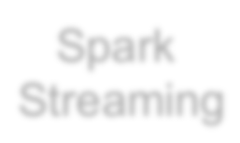
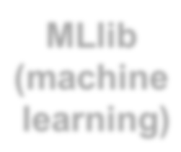









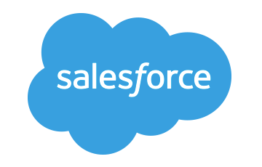












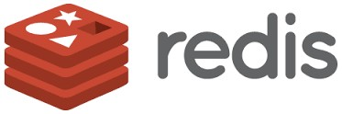
Spark Ecosystem
executes SQL statements
performs streaming analytics using micro-batches
common machine learning and
statistical algorithms
distributed graph processing framework
Execute R
Statistical code against Spark Code
Spark SQL
Spark Streaming
MLlib (machine learning)
GraphX (graph)
SparkR
general compute engine, handles
distributed task dispatching,
scheduling and basic I/O functions
Spark Core Engine
large variety of data sources and formats can be
supported, both on premise or cloud
BigInsights (HDFS)
Cloudant
dashDB
SQL DB
Object Storage
…many others
IBM CLOUD
OTHER CLOUD
CLOUD APPS
ON-PREMISE
Notes:
Spark includes a set of core libraries that enable various analytic methods which can process data from many sources (Spark is completely agnostic to data sources)
Along the bottom are the large variety of data sources and formats that can be supported, both on premise or cloud
In the middle, is the general compute engine, which handles distributed tasks, dispatching and basic I/O functions
At the top – are the Spark libraries

Slide 18










Libraries Usage
SparkSQL − 69%
Spark SQL
Spark Streaming
MLlib
Machine Learning
GraphX
Graphing
DataFrames − 62%
Spark Streaming − 58%
MLlib/GraphX − 58%
Spark Core
75% of users use more than one component
Notes:
Note that DataFrames are datasets that make the data look like relational tables.
From this chart, we can conclude that SQL access to data is the most popular interface used. Some would say it is ironic considering all the NoSQL hoopla of the last several years. This points to the fact that people want more productivity through the use of simpler interfaces. The SQL approach has that advantage and also potentially removes many performance burdens from a programmer.
*** We will get hands on with SparkSQL in Lab 2 today
*** We will also get hands on with MLlib in Lab 3

Slide 19
Spark Programming Languages
Language | 2014 | 2015 | 2016
Scala | 84% | 71% | 65%
Java | 38% | 31% | 29%
Python | 38% | 58% | 62%
R | unknown | 18% | 20%
Notes:
Reference: Survey by Databricks
This chart shows that usage of programming languages is changing… This is not to say that scala is becoming less popular, it is likely because the type of people adopting Spark are coming more and more from a data science background which favors the use of Python and R.
**More data scientists are using Spark**

Slide 20
IBM is all-in on Spark
"It's like Spark just got blessed by the enterprise rabbi."
Contribute to the Core
Launch Spark Technology Cluster (STC), 300 engineers
Open source SystemML
Partner with databricks
Ben Horowitz,
Andreessen Horowitz
Foster Community
Infuse the Portfolio
Educate 1M+ data scientists and engineers via online courses
Sponsor AMPLab, creators and evangelists of Spark
Integrate Spark throughout portfolio
3,500 employees working on Spark-related topics
Spark however customers want it – standalone, platform or products
Notes:
We are all in on spark
We have a center in San Francisco where our engineers are dedicated to contributing to spark, they do not work on any other project
We aim to hire about 300 engineers, we are as many 70 as of now
We have also developed and open sourced SystemML which is a machine learning library
We also offer sponser AMPLab where spark was born and we are continuing to invest in RiseLab
There is also free education on big data university for spark and other big data courses
And lastly, spark is a component in a lot of our products and the number is rising, we also offer it on a standalone basis
The quote in the upper right corner is important. It shows the impact IBM has when it supports a product.
It gives legitimacy to Spark for the enterprise. Now enterprise customers can use Spark and know that IBM is behind it. It is appropriate for enterprise software.
Still, IBM wants to make sure it is successful by using this three pronged approach.
One of the main goal being to become the number one contributor to Spark.

Slide 21
Spark Terminology
Context (Connection):
Represents a connection to the Spark cluster. The Application which initiated the context can submit one or several jobs, sequentially or in parallel, batch or interactively.
Driver (Coordinator agent)
The program or process running the Spark context. Responsible for running jobs over the cluster and converting the App into a set of tasks
Job (Query / Query plan):
A piece of logic (code) which will take some input from HDFS (or the local filesystem), perform some computations (transformations and actions) and write some output back.
Stage (Subplan)
Jobs are divided into stages
Tasks (Sub section)
Each stage is made up of tasks. One task is executed on one partition (of data) by one executor
Executor (Sub agent)
The process responsible for executing a task on a worker node
Notes:
Context – Handle to your cluster, each application will have its own context. At a given point of time, there can be several contexts on a cluster
Driver – Works hand in hand with the context, it is a program which runs on the master node and is responsible for generating an execution plan (DSX?)
Job – a single piece of code which you will submit to the cluster (and this job will be divided by the driver into smaller pieces to be run on worker nodes) - - (this will be done in labs 1 and 2)
Stage – a part of the job (you will observe as the job is run in stages within DSX)
Tasks - the most atomic piece of code, this runs on the worker nodes, each worker node will have a single task for the given job.

Slide 22
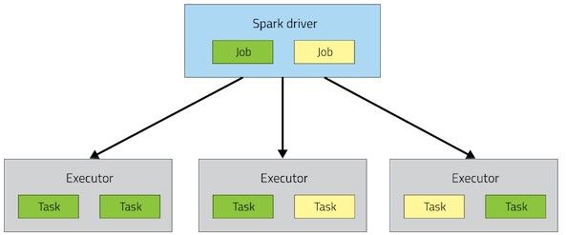
Spark Architecture
Application

Slide 23
A Spark application is initiated from a driver program
Each Spark application runs as a set of processes coordinated by the Spark context object (driver program)
– Spark context connects to Cluster Manager (standalone, Mesos/Yarn)
Spark context acquires executors (JVM instance) on worker nodes
Spark context sends tasks to the executors
Worker Node
Executor
Cache
Task
Task
Driver Program
Cluster Manager
App
SparkContext
Worker Node
Executor
Cache
Task
Task
Notes:
Driver Program – Python?
Spark Context – connection to the cluster/Spark service (running in the background)

Slide 24
Resilient Distributed Datasets
RDD is a distributed collection of Scala/Python/Java objects of the same type:
Strings
Integers
(key, value) pairs
class Java/Python/Scala objects
RDDs are immutable
Modifications create new RDDs
Physically distributed across cluster, but manipulated as one logical entity:
Spark will “distribute” any required processing to all partitions where the RDD exists and perform necessary redistributions and aggregations as well.
Example: Consider a distributed RDD “Names” made of names
Partition 1
Partition 2
Partition 3
Names
Mokhtar Jacques Dirk
Cindy Dan Susan
Dirk Frank Jacques
Notes:
Primary data type in Spark - Spark is based on the concept of a Resilient Distributed Dataset (RDD).
*The key to parallel processing in Spark is the partitioning of an RDD.
For example, if an RDD comes from an HDFS file, it will be partitioned based on the number of blocks available. There are transformations in Spark that allows to repartition an RDD to improve the overall performance by either increasing or even decreasing the number of partition. In general RDD partitions are kept in-memory, but parameters can be set to allow for spilling to disk if needed.
An RDD cannot be modified. Any transformation on an RDD will result is a new RDD. An RDD resilience lies in the fact that it keeps track of where it came from. If an RDD is lost for any reason, it can be reconstructed from one of its ancestors. This chain of modifications is referred to as lineage.
In the execution of a Spark application, multiple RDDs are created since RDDs are immutable. This means that the memory requirements can be much greater than the size of the input file. For this reason, RDDs can be removed during the processing. If they happen to be needed later, they can be recreated from their lineage. To help performance, it is possible to “persist” an RDD so it would not have to be re-created.
It is a basic unit of computation…. Just as a database holds tables...and those tables can then contain data of different types, an RDD is a unit which contains data in the spark world.

Slide 25
Resilient Distributed Datasets
Suppose we want to know the number of names in the RDD “Names”
User simply requests: Names.count()
Spark will “distribute” count processing to all partitions so as to obtain:
Partition 1: Mokhtar(1), Jacques (1), Dirk (1) è 3
Partition 2: Cindy (1), Dan (1), Susan (1) è 3
Partition 3: Dirk (1), Frank (1), Jacques (1) è 3
Local counts are subsequently aggregated: 3+3+3=9
To lookup the first element in the RDD: Names.first()
To display all elements of the RDD: Names.collect() (careful with this)
Names Partition 2
Partition 1
Partition 3
Mokhtar Jacques Dirk
Cindy Dan Susan
Dirk Frank Jacques
Notes:
The collect () method will print all elements on the driver, and can cause the driver to run out of memory - - because collect() fetches the entire RDD to a single machine; if you only need to print a few elements of the RDD, a safer approach is to use the take(). For example names.take (2)

Slide 26
RDDs
Two types of operations
Transformations
Actions
Fault tolerance
If data in memory is lost it will be recreated from lineage
Notes:
Transformations – creates a new dataset from an existing one
Ex: Map is a transformation that takes each element in an RDD and passes it through a function - and returns new RDD containing results
Actions – return a value to the driver program after running a computation on a dataset
Ex: Reduce is an action that aggregates all of the elements of an RDD using some function, and returns the final result to the driver program
All transformations in Spark are lazy, in that they do not compute their results right away. Instead, they just remember the transformations applied to some base dataset (e.g. a file). The transformations are only computed when an action requires a result to be returned to the driver program. This design enables Spark to run more efficiently. For example, we can realize that a dataset created through map will be used in a reduce and return only the result of the reduce to the driver, rather than the larger mapped dataset.
By default, each transformed RDD may be recomputed each time you run an action on it. However, you may also persist an RDD in memory using the persist (or cache) method, in which case Spark will keep the elements around on the cluster for much faster access the next time you query it. There is also support for persisting RDDs on disk, or replicated across multiple nodes.
Fault Tolerance - - if any partition of an RDD is lost, it will automatically be recomputed using the transformations that originally created it

Slide 27
Code Execution (1)
// Create RDD
val quotes = sc.textFile("hdfs:/sparkdata/sparkQuotes.txt")
// Transformations
val danQuotes = quotes.filter(_.startsWith("DAN"))
val danSpark = danQuotes.map(_.split(" ")).map(x => x(1))
// Action
danSpark.filter(_.contains("Spark")).count()
// Create RDD
val quotes = sc.textFile("hdfs:/sparkdata/sparkQuotes.txt")
// Transformations
val danQuotes = quotes.filter(_.startsWith("DAN"))
val danSpark = danQuotes.map(_.split(" ")).map(x => x(1))
// Action danSpark.filter(_.contains("Spark")).count()
File: sparkQuotes.txt
DAN Spark is cool BOB Spark is fun
BRIAN Spark is great DAN Scala is awesome BOB Scala is flexible

Slide 28
Code Execution (2)
// Create RDD
val quotes = sc.textFile("hdfs:/sparkdata/sparkQuotes.txt")
// Transformations
val danQuotes = quotes.filter(_.startsWith("DAN"))
val danSpark = danQuotes.map(_.split(" ")).map(x => x(1))
// Action
danSpark.filter(_.contains("Spark")).count()
File: sparkQuotes.txt
RDD: quotes
DAN Spark is cool BOB Spark is fun
BRIAN Spark is great DAN Scala is awesome BOB Scala is flexible

Slide 29
Code Execution (3)
// Create RDD
val quotes = sc.textFile("hdfs:/sparkdata/sparkQuotes.txt")
// Transformations
val danQuotes = quotes.filter(_.startsWith("DAN"))
val danSpark = danQuotes.map(_.split(" ")).map(x => x(1))
// Action
danSpark.filter(_.contains("Spark")).count()
File: sparkQuotes.txt
RDD: quotes
RDD: danQuotes
DAN Spark is cool BOB Spark is fun
BRIAN Spark is great DAN Scala is awesome BOB Scala is flexible

Slide 30
Code Execution (5)
// Create RDD
val quotes = sc.textFile("hdfs:/sparkdata/sparkQuotes.txt")
// Transformations
val danQuotes = quotes.filter(_.startsWith("DAN"))
val danSpark = danQuotes.map(_.split(" ")).map(x => x(1))
// Action
danSpark.filter(_.contains("Spark")).count()
File: sparkQuotes.txt
RDD: quotes
RDD: danQuotes
RDD: danSpark
DAN Spark is cool BOB Spark is fun
BRIAN Spark is great DAN Scala is awesome BOB Scala is flexible

Slide 31
Code Execution (5)
// Create RDD
val quotes = sc.textFile("hdfs:/sparkdata/sparkQuotes.txt")
// Transformations
val danQuotes = quotes.filter(_.startsWith("DAN"))
val danSpark = danQuotes.map(_.split(" ")).map(x => x(1))
// Action
danSpark.filter(_.contains("Spark")).count()
File: sparkQuotes.txt
RDD: quotes
RDD: danQuotes
RDD: danSpark
DAN Spark is cool BOB Spark is fun
BRIAN Spark is great DAN Scala is awesome BOB Scala is flexible
DAN Spark is cool BOB Spark is fun
BRIAN Spark is great DAN Scala is awesome BOB Scala is flexible
DAN Spark is cool DAN Scala is awesome
Spark Scala
1
Notes:
Started with our ’quotes’ RDD, and each transformation (filter, map) created an additional RDD
Lastly, action to give us a count of “Spark” from the danSpark RDD (1)

Slide 32
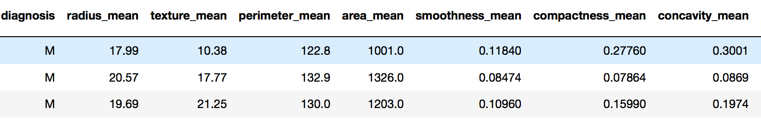
DataFrames
Similar to Pandas DataFrames
Same principles as an RDD
All spark libraries can now handle DataFrames
Notes:
SparkSQL, DataFrames and Datasets –
A rich set of functionality that allows “database-like” processing
*Make the data look like relational tables (SQL like interface)

Slide 33
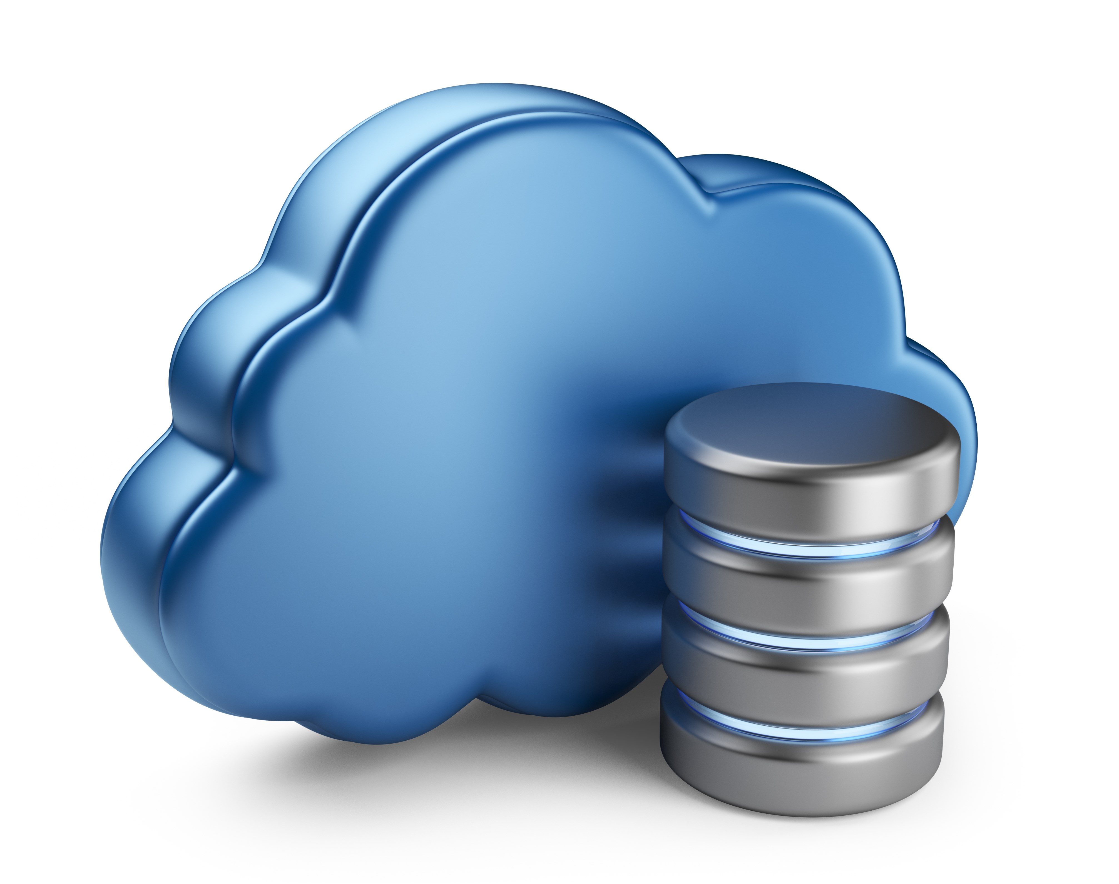
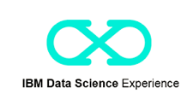


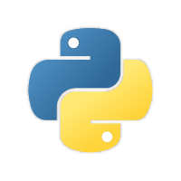



Sample Architecture
Source / Backend
Application development
Deployment
Scheduler
GitHub
Monitoring Dashboard
Maintenance / Updates
Notes:
Need explanation on this slide

